Slide 1
Integrating RACI and Relationship Management
Effective project management requires clearly defined roles and responsibilities. By integrating the RACI matrix with the 12 levels of relationship management, organizations can optimize the assignment of tasks and decision-making, ensuring the right people are involved at the appropriate levels based on the depth of their professional connections.
by Khan Baba

Slide 2
The RACI Matrix: Roles Defined
1
Responsible (R)
2
Accountable (A)
The person or team directly responsible for completing a task or deliverable.
The person who has ultimate ownership of the task's outcome; they must ensure the task is completed.
3
Consulted (C)
4
Informed (I)
Individuals whose input is sought during the project or task for advice, expertise, or approval.
People who need to be kept updated on progress or decisions but do not directly participate.

Slide 3
Relationship Levels and RACI Roles
Qareen (Inseparable)
Safiyy (Best Friend)
Najiyy (Confidant)
Responsible (R) and Accountable (A) RACI roles. Trusted business partners and co-founders who share deep knowledge and understanding of each other's working styles.
Responsible (R) and Accountable (A) RACI roles. Key strategic partners and long-term business allies who are highly reliable.
Consulted (C) and Accountable (A) RACI roles. Senior advisors, mentors, and board members whose expertise and judgment are trusted.

Slide 4
Relationship Levels and RACI Roles (Continued)
1
Anees (Comfortable)
Responsible (R) and Consulted (C) RACI roles. Key team members or operational partners who are familiar with the way you work and can be trusted to get things done efficiently.
2
Khaleel (Intimate Friend)
Responsible (R) and Consulted (C) RACI roles. Close professional collaborators and key team leaders whose involvement energizes the team and inspires confidence in delegating responsibilities.
3
Sadeeq (True Friend)
Consulted (C) and Accountable (A) RACI roles. Trusted long-term contacts and collaborators who provide honest, unbiased feedback, making them invaluable for strategic decisions.

Slide 5
Relationship Levels and RACI Roles (Continued)
Rafeeq (Dependable)
Sahib (Concerned for Well-Being)
Responsible (R) and Accountable (A) RACI roles. Reliable colleagues and team members who can be trusted to execute plans effectively without needing much oversight.
Informed (I) and Consulted (C) RACI roles. Supervisors, managers, or support staff who are concerned for your success but not directly involved in day-to-day tasks.
Nadeem (Casual Companion)
Sameer (Good Conversationalist)
Consulted (C) and Informed (I) RACI roles. Casual business contacts and occasional collaborators who can provide helpful feedback on a more informal basis.
Consulted (C) and Informed (I) RACI roles. Intellectual peers or casual professional contacts who can offer interesting perspectives during discussions but are not deeply involved in decision-making.

Slide 6
Relationship Levels and RACI Roles (Continued)
Jalees (Comfortable Acquaintance)
Zameel (Nodding Acquaintance)
Informed (I) RACI role. Extended network contacts or acquaintances who are kept updated as a courtesy but not relied upon for major tasks.
Informed (I) RACI role. Networking connections and distant colleagues who receive only broad updates to maintain a peripheral connection.

Slide 7
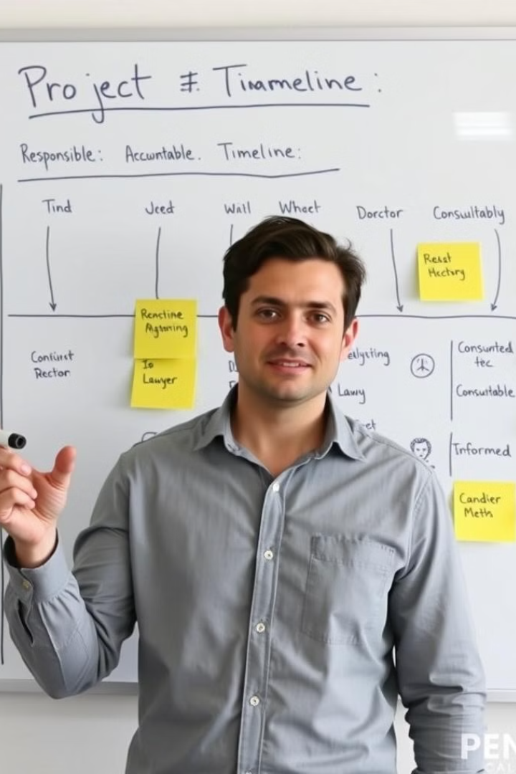
Applying RACI and Relationship Levels
Task Assignment
Assign Responsible roles to Qareen, Safiyy, or Rafeeq-level contacts who are trusted partners with close ties.
Decision-Making
Involve Najiyy, Sadeeq, and Khaleel-level contacts in Consulted roles to leverage their expertise and judgment for strategic matters.
Informing Stakeholders
Keep those further out in the relationship spectrum (Sameer, Jalees, Zameel) Informed to maintain connections without involving them directly in execution or decision-making.

Slide 8
Benefits of Integrating RACI and Relationship Management
1
Improved Efficiency
By aligning the right people with the right roles based on their relationship levels, tasks are completed more effectively, and decision-making is streamlined.
2
Enhanced Collaboration
The integration of RACI and relationship management fosters a culture of trust, open communication, and accountability, leading to stronger teamwork and better project outcomes.
3
Optimized Stakeholder Management
Keeping the appropriate stakeholders informed at the right level helps manage expectations, mitigate risks, and maintain positive relationships throughout the project's lifecycle.

Slide 9
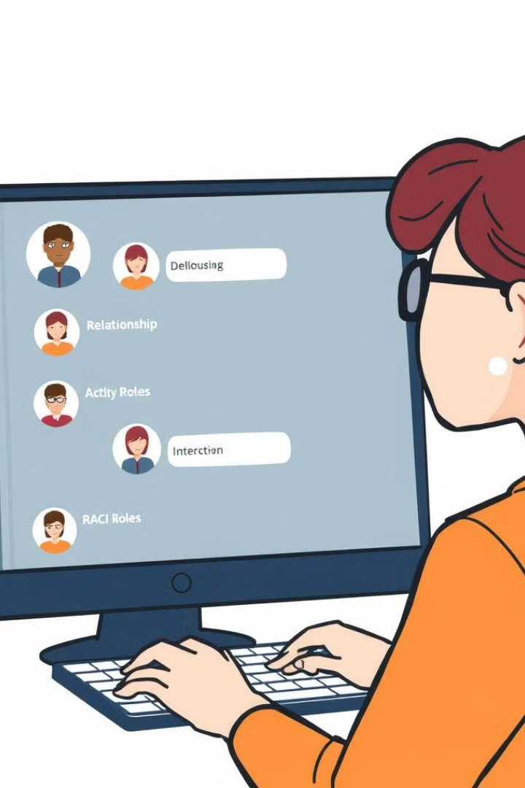
Implementing the Integrated Approach
Identify Relationship Levels
Assess the depth of your relationships with each contact and categorize them into the 12 levels.
Assign RACI Roles
Determine the appropriate RACI roles for each contact based on their relationship level and expertise.
Integrate into Workflows
Incorporate the RACI and relationship management framework into your project management processes and communication strategies.
Review and Adjust
Regularly review and update the RACI assignments and relationship levels to ensure they align with the evolving project needs and team dynamics.

Slide 10
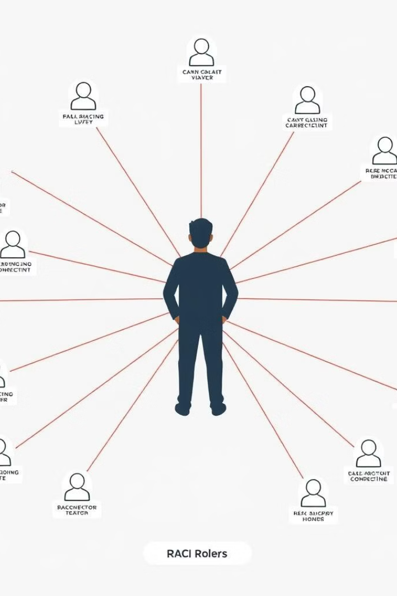
Conclusion: Optimizing Project Roles and Relationships
By integrating the RACI matrix with the 12 levels of relationship management, organizations can effectively assign roles, responsibilities, and decision-making authority based on the depth of their professional connections. This holistic approach fosters greater efficiency, collaboration, and stakeholder management, ultimately leading to more successful project outcomes.

